Slide 1
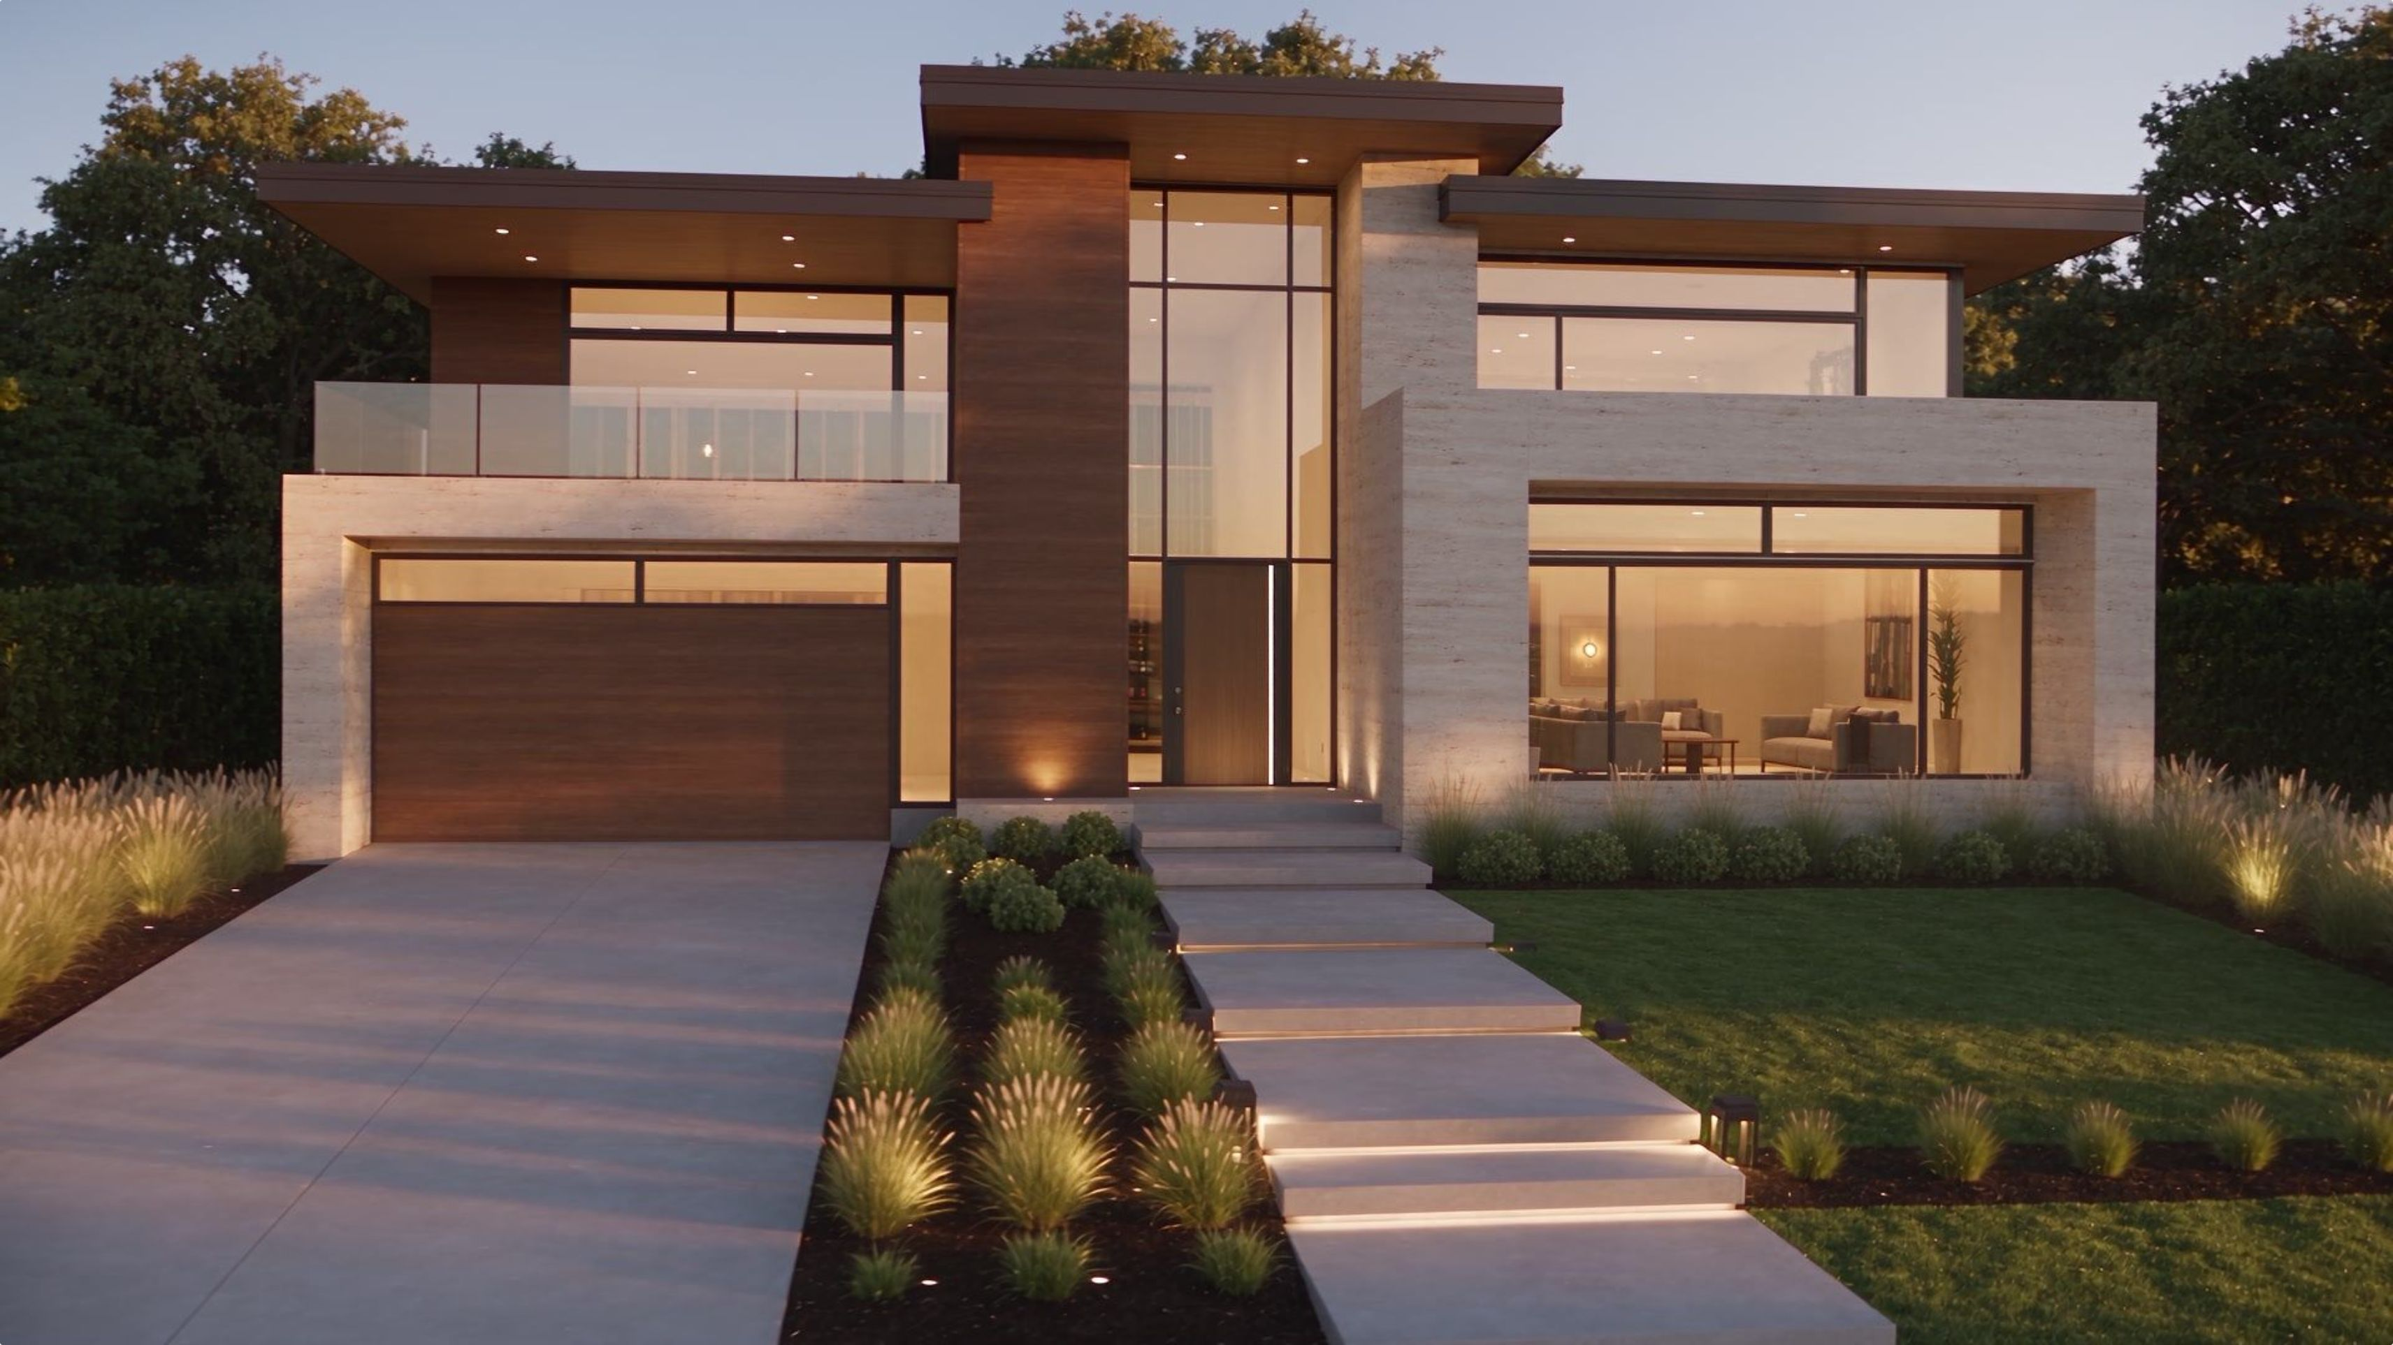
Aurelian Ridge
The project you watched take shape
Nucleus + NOAH · A review presentation for Donnie and Larry
Fictional architectural concept

Slide 2
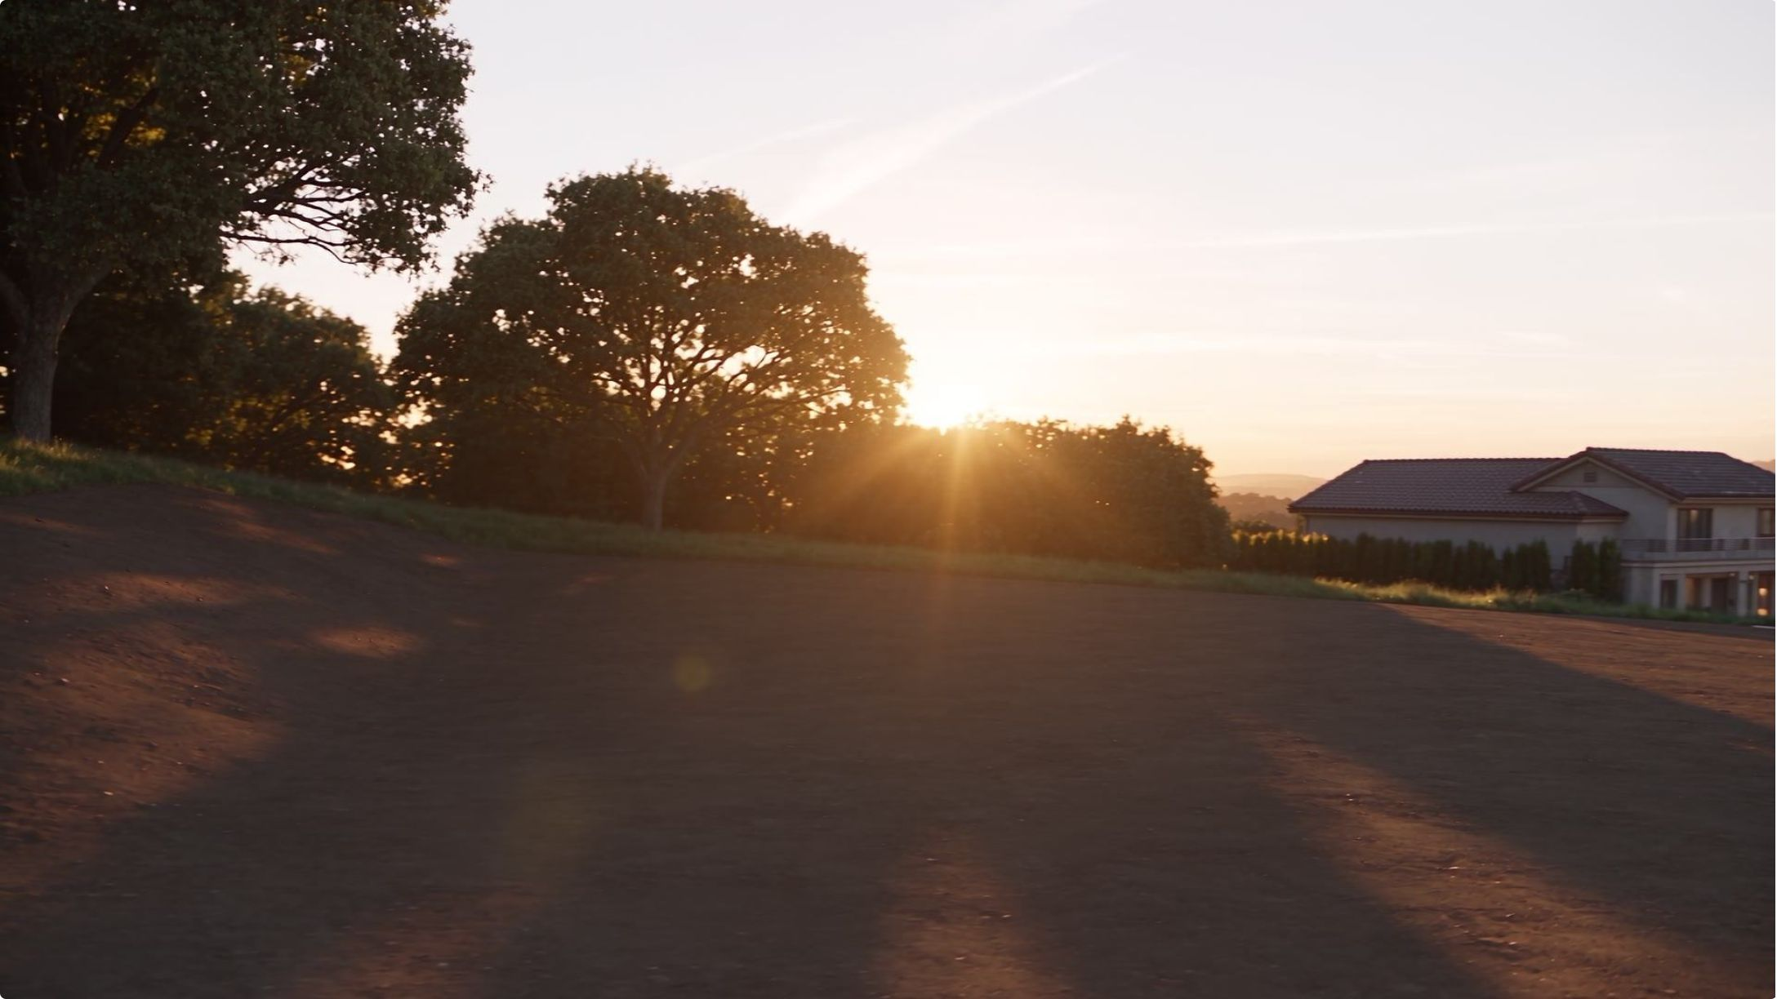
A spoken brief became a project
Donnie described a home rising from open land, with a finished landscape and an aerial view of the surrounding community. The assignment expanded into a website and supporting material an architect could review.
The person provides direction in ordinary language. Nucleus and NOAH carry that direction into project work that can be opened, checked and revised.

Slide 3

The actual console workflow
01
The demonstration used the real application and saved outputs. The later screen recording captures revisions and review. Recording began after the initial project creation.
Describe the project
Describe the project in the conversation.
02
This is an explanation of the observed workflow, not a screenshot of the interface.
Open Work
Open Work to inspect the saved files.
03
Preview each output
Preview each output and scroll through its full contents.
04
Describe a correction
Describe a correction, then check the saved revision.
05
Download and review
Download the completed project and review it in the browser.

Slide 4
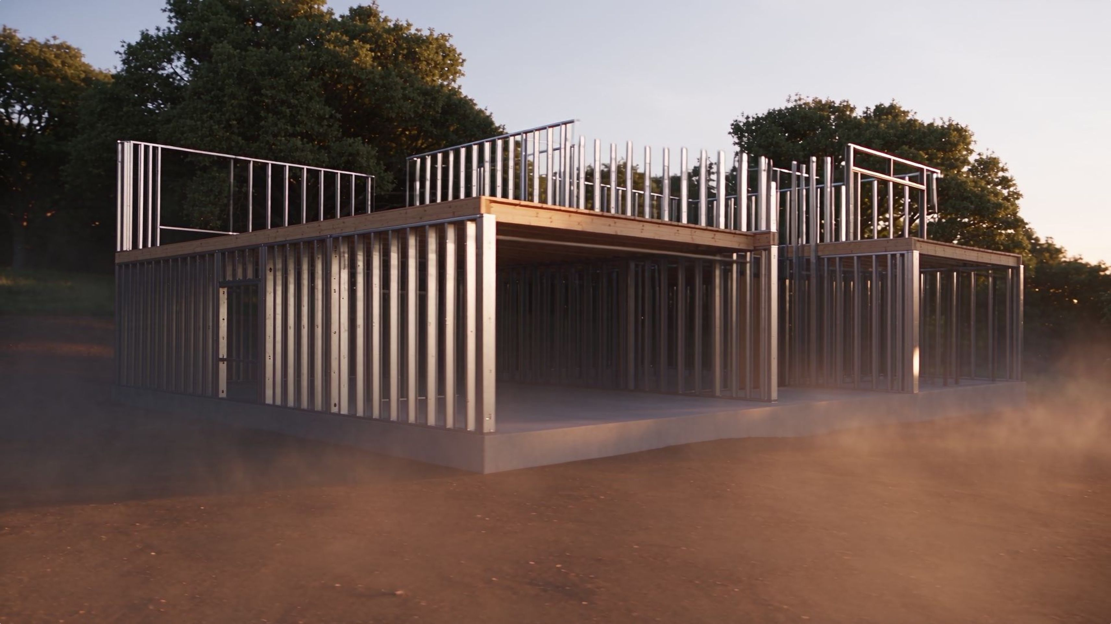

The cinematic build
The 24-second concept film shows the same residence through successive stages: open land, structure, finished limestone, cedar and glass, then landscaping and the community reveal.
Higgsfield produced the architectural film within the coordinated project workflow.
Open land
Structure
The site before construction begins
The frame rising from the ground
Materials
Community
Limestone, cedar and glass applied
Aerial reveal of the surrounding landscape
AI-generated architectural visualization. This does not document an actual construction site.

Slide 5
Six saved deliverables
The website presents the residence, film, visual stages and supporting project material.
1
README
Explains the package and how to open it.
2
Project Brief
Preserves the assignment and its scope.
3
Community Concept Specification
Describes the design intent and open questions.
4
Architectural Concept Sheet
Presents materials, phases and a schematic relationship diagram.
5
Project Intake Form
Lets a reviewer enter goals, review the draft and export it.
6
Website Package
All six files were saved through the project and the exact downloads were verified.

Slide 6

A correction you could see
The initial intake form cleared the draft immediately. Donnie's workflow showed how a plain-language revision could become a saved change.
The revised form asks for confirmation. Cancel preserves the draft. Confirming Clear removes it.
The review also verified that empty required fields block submission, a fictional example loads, and edited priorities appear in the review.
These are observed results from the completed form. The demonstration uses fictional information and keeps the draft local.
Before
Clearing the form removed the draft immediately — no confirmation step.
After
The revised form asks for confirmation. Cancel preserves the draft. Confirming Clear removes it.
Also verified
Empty required fields block submission. A fictional example loads. Edited priorities appear in the review.

Slide 7
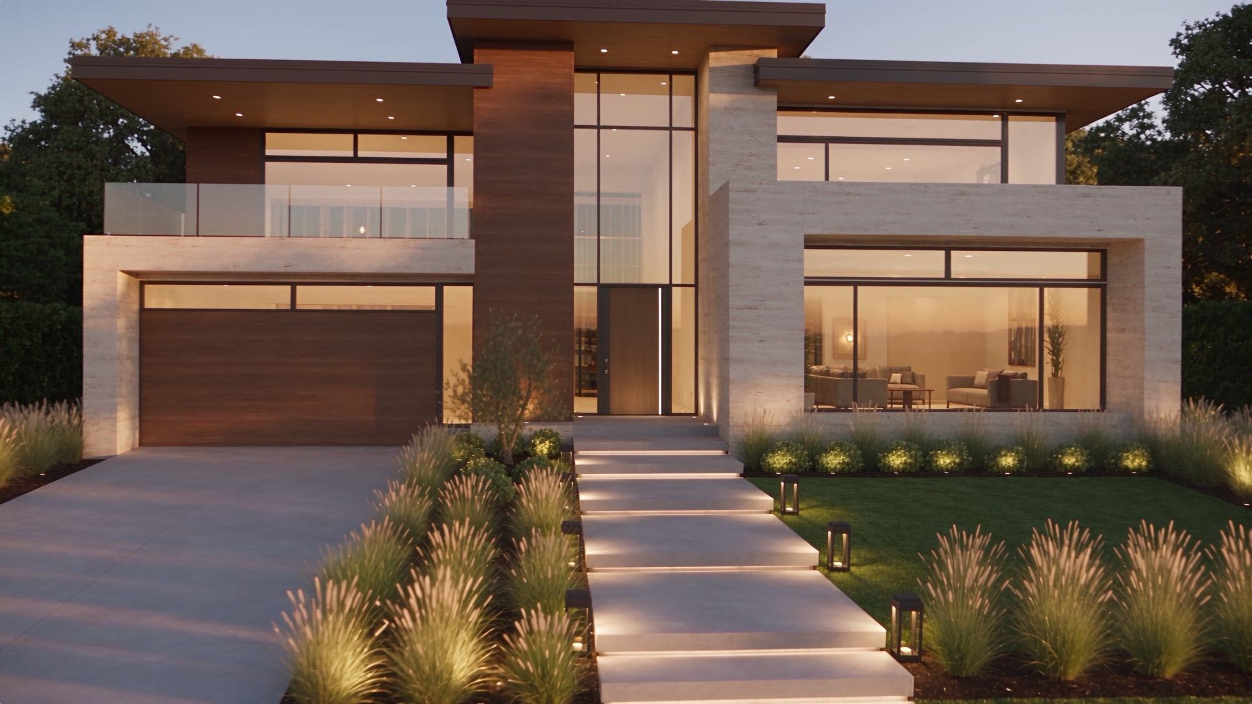
One visual concept across the package
The landscape, materials and residence imagery follow the same cinematic direction. The documents make that direction available for the next conversation with an architect.
The concept sheet identifies unknown site facts and shows a schematic relationship diagram.
Concept only. The diagram is not measured, not to scale and not for construction. A qualified design team would develop a real parcel, engineering and approvals.

Slide 8
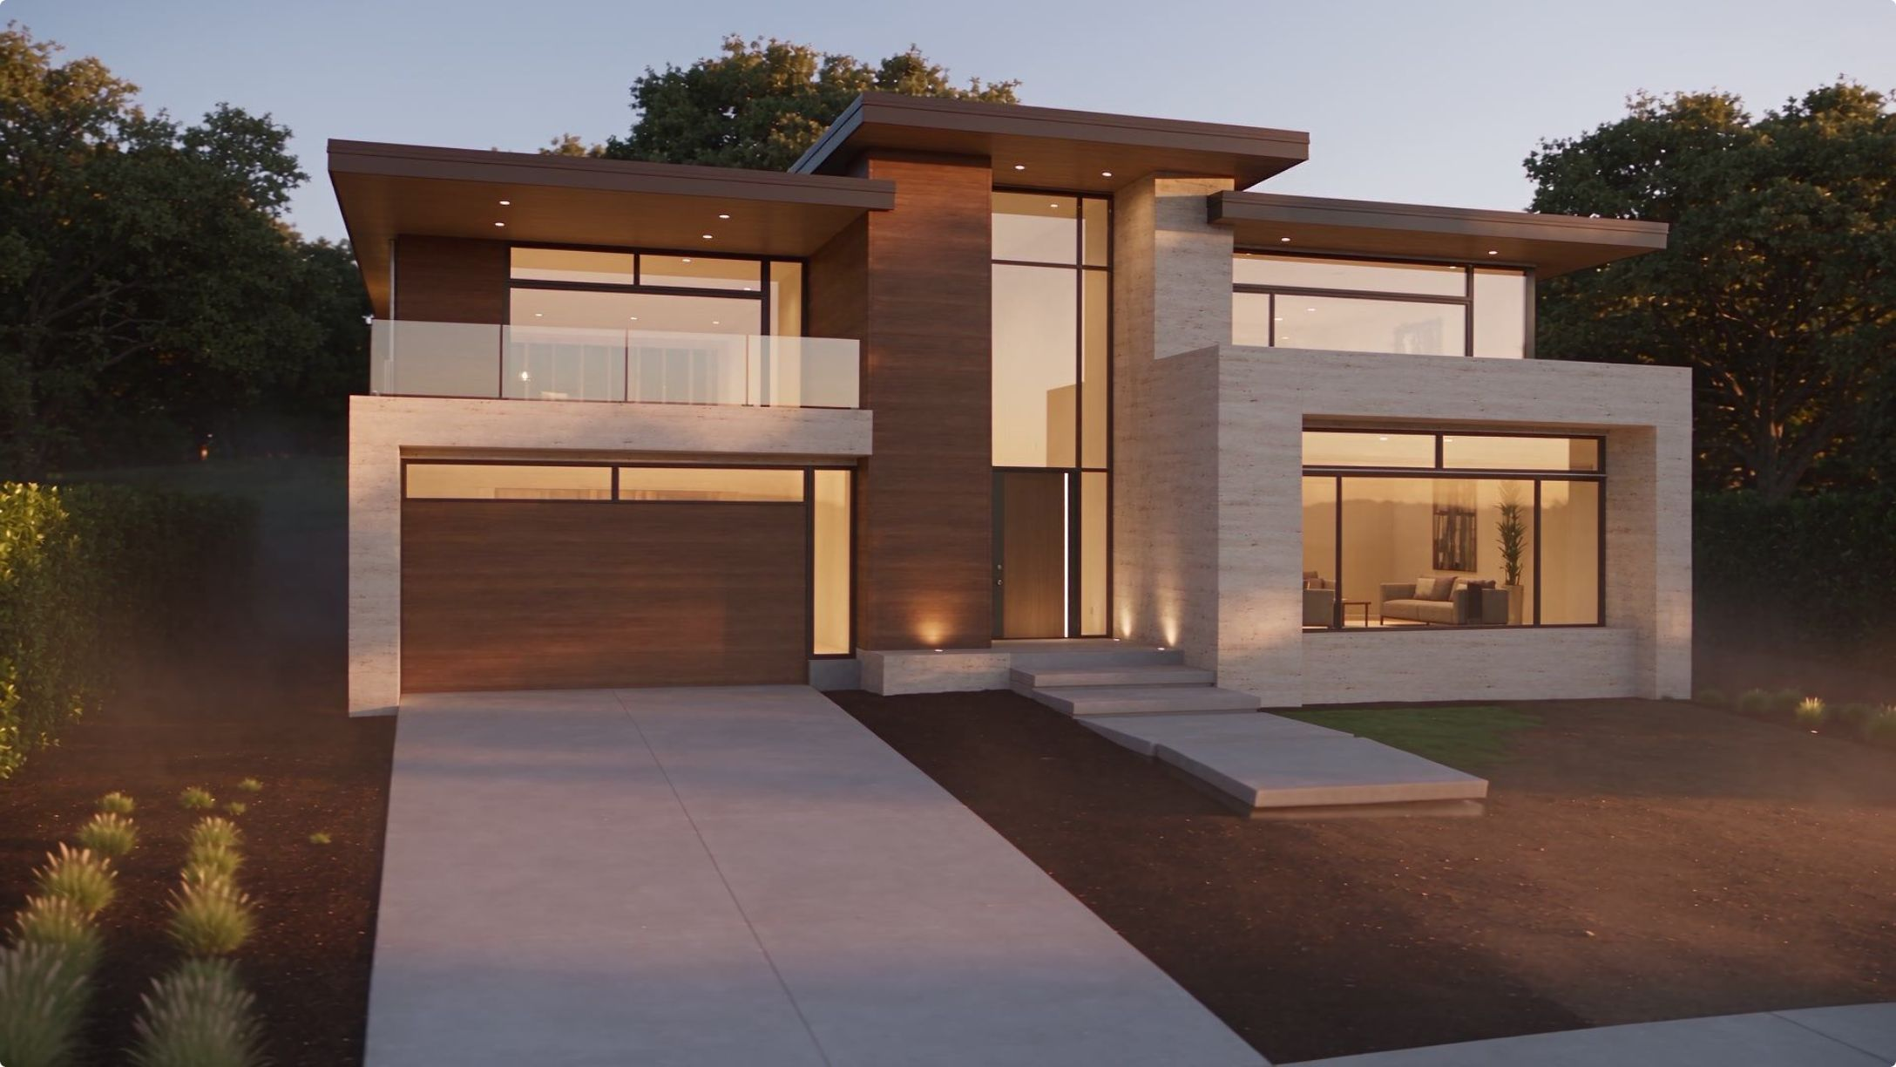
What is ready to review
This presentation lets you review the completed concept project now. It does not represent the unfinished narrated tutorial as complete.
✓ Completed
In production
The six-file website package, the 24-second cinematic film, and the demonstrated intake correction.
The full narrated application tutorial, including real clicks, shortened waits and the finished-output ending.

Slide 9
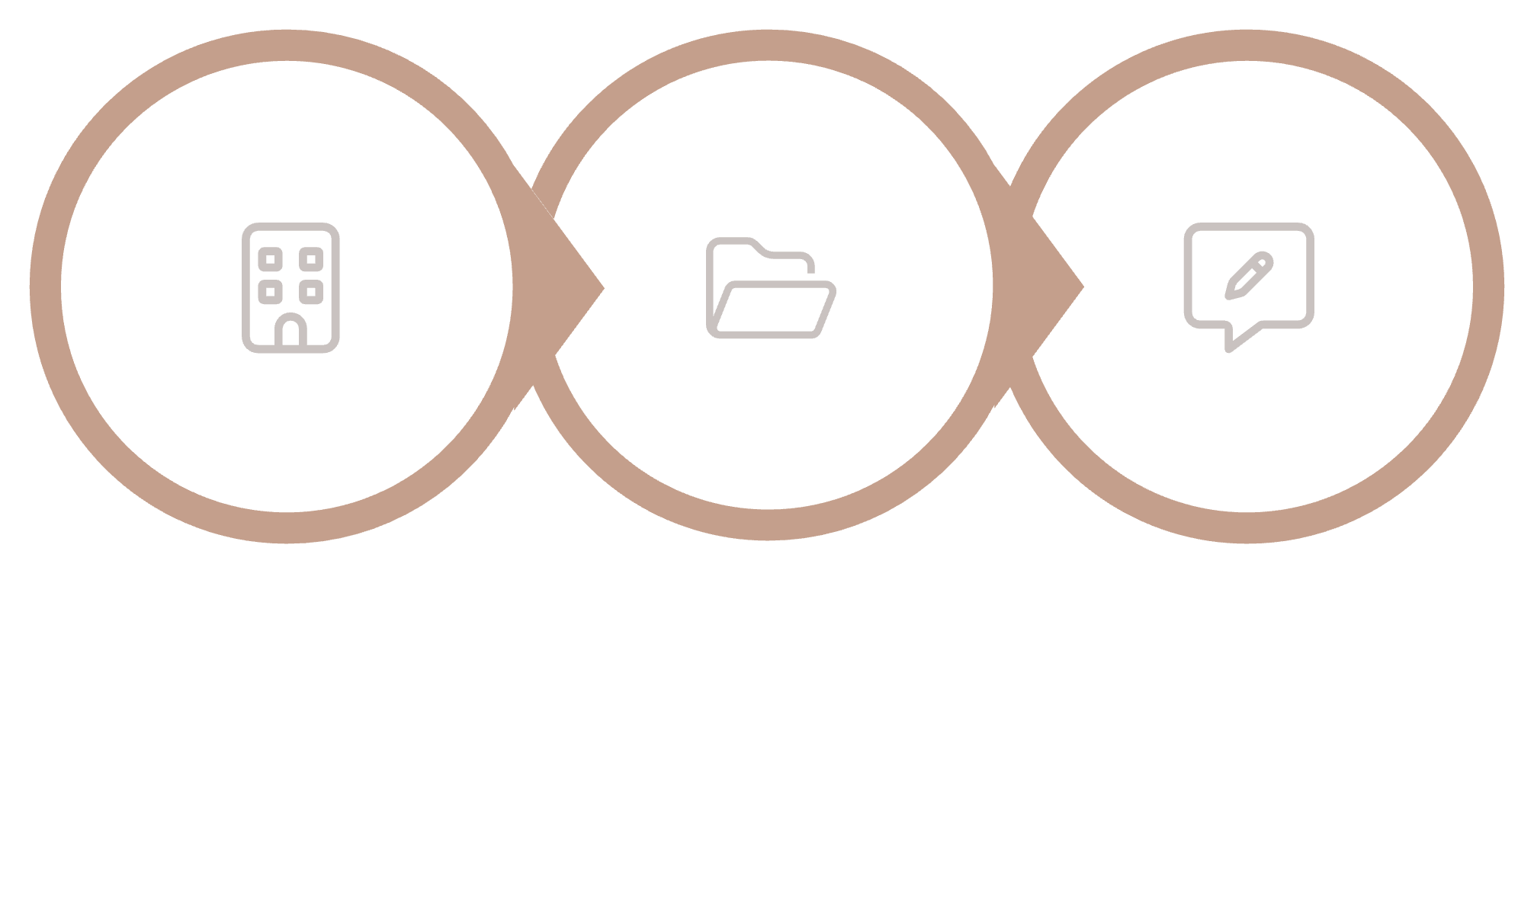
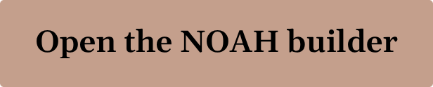

Your own project starts here
Open the builder, describe the result you want and give it the material you want to use. Review the saved output in Work. Continue the conversation when something should change.
Open Builder
Review Work
Refine
The useful habit is to inspect each result and give the next instruction in your own words.

Slide 10
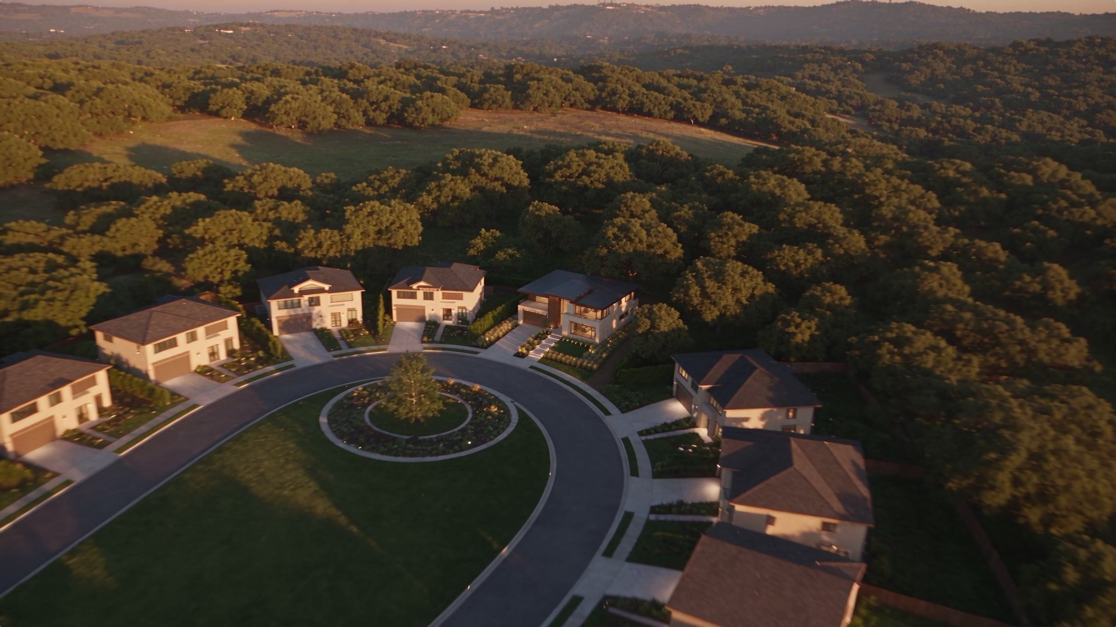

The Residence at Aurelian Ridge
From open land to a life imagined.
The completed concept brings the residence, landscape, website and supporting documents into one project.
Fictional community concept

